Slide 1
Towan Nöthling
Chris Engelbrecht summer school
Lecture 1

Slide 2
My lectures:
Conceptual introduction of quantum mechanics in photosynthetic systems
Energy transfer and spectroscopy in photosynthetic systems
Overview and examples of quantum biology
Notes:
if you wonder whether the QM has fixed your car, the answer is yes and no

Slide 3
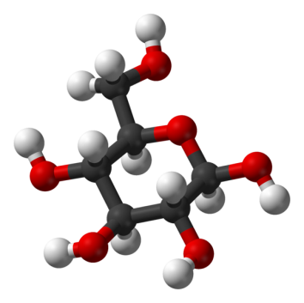
Photosynthesis

Slide 4
Photosynthesis
Produces:
kg organic matter per year
Energy at a rate of 130 TW (ten times the human consumption)
kg O₂ per year (enough to supply humans for 190 years)

Slide 5
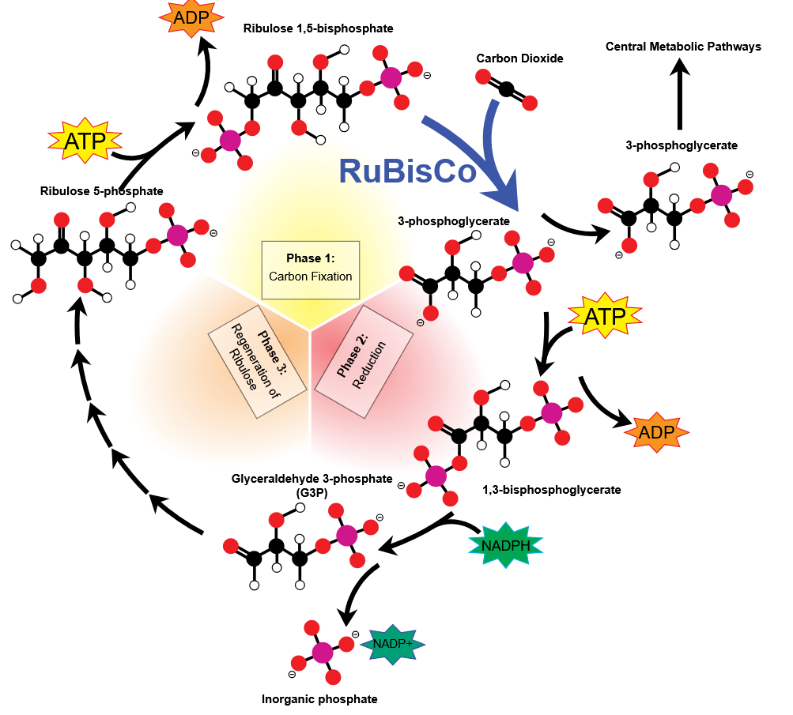
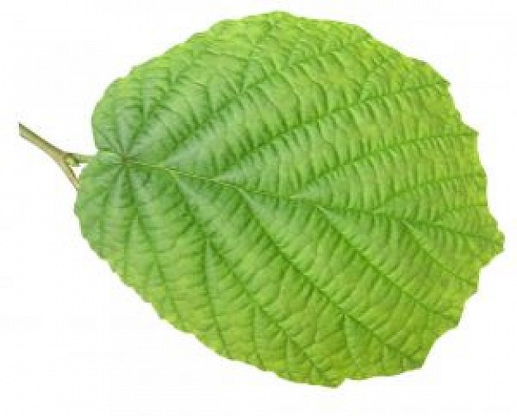
Mike Jones, CC BY SA 3.0. Wikimedia Commons
Light-dependent phase
Light-independent phase

Slide 6
Mike Jones, CC BY SA 3.0. Wikimedia Commons
Light-dependent phase
Light-independent phase

Slide 7
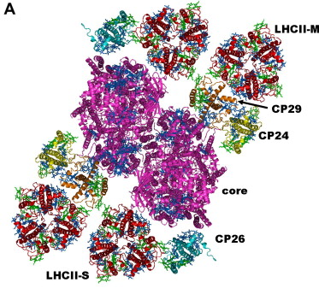
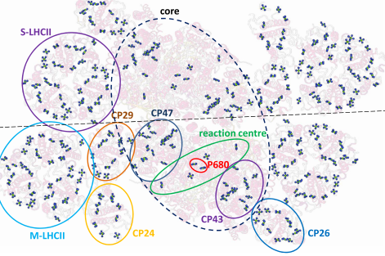
Thylakoid membrane
Cells with green
chloroplasts
Photosystem
Notes:
water is split

Slide 8
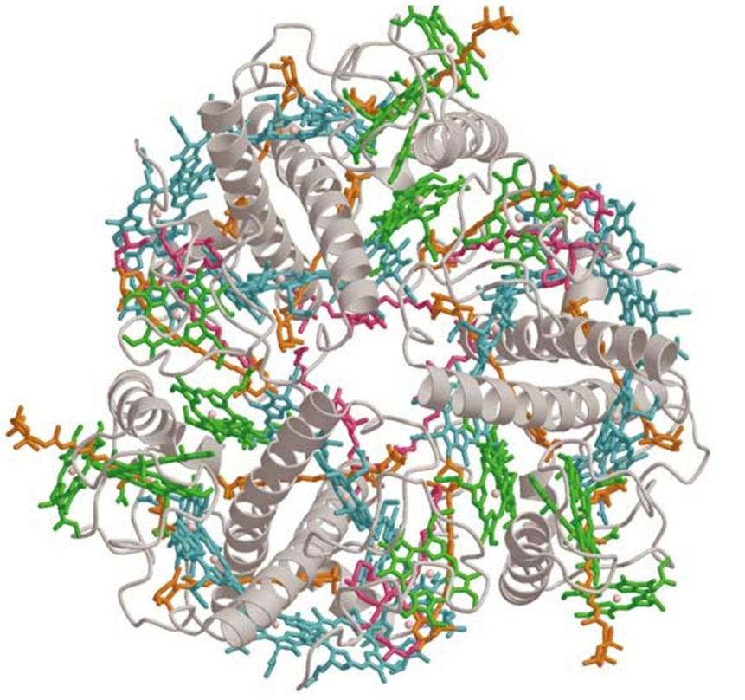
LHCII
Thylakoid membrane
Cells with green
chloroplasts
Protein + pigments = a complex
Photosystem
light-harvesting complex

Slide 9
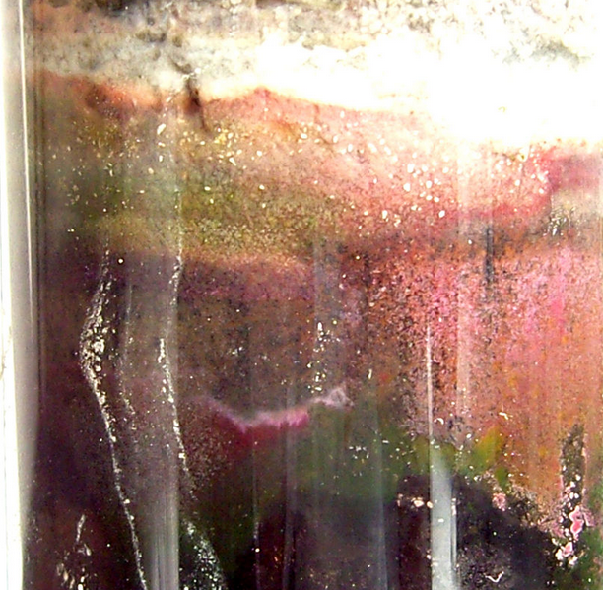
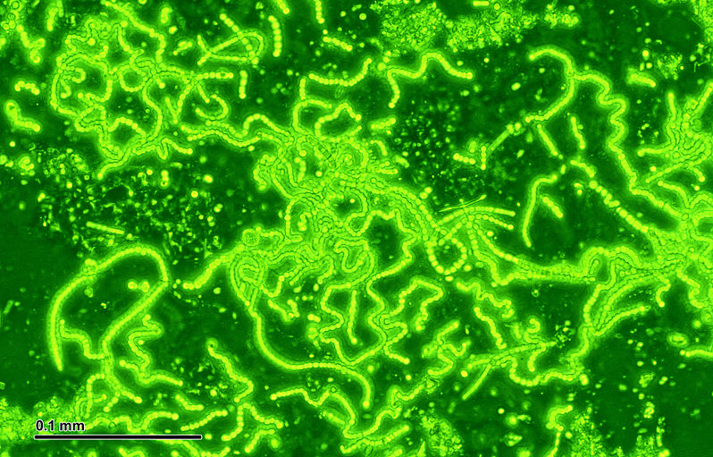
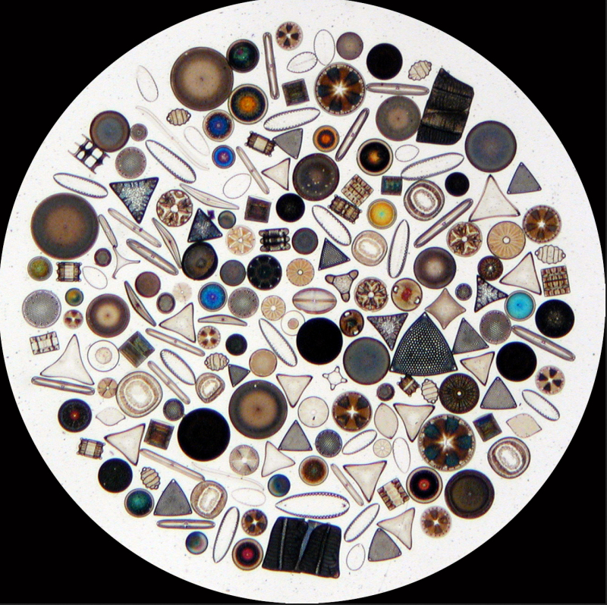
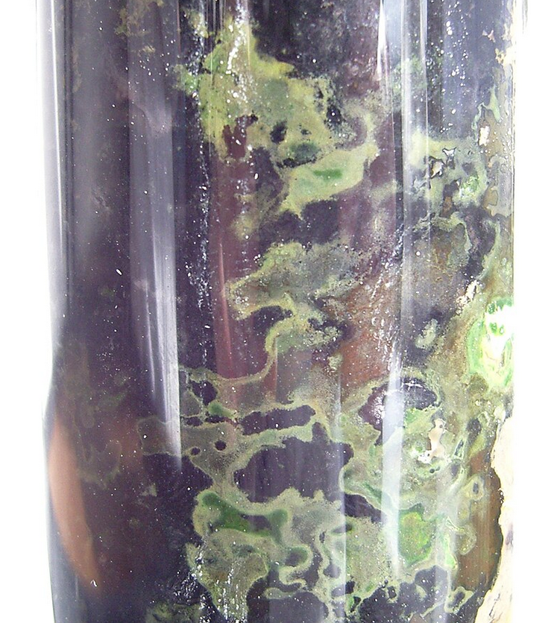
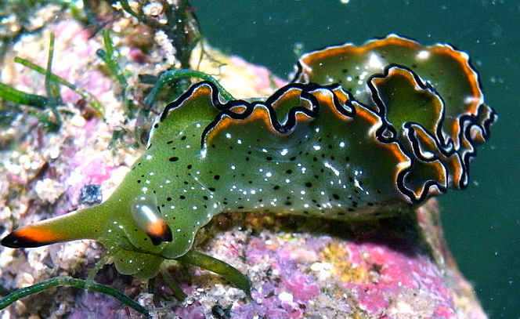
purple sulphur bacteria
Diego Delso, CC BY-SA 4.0
Josef Reischig, CC BY-SA 3.0
plants
cyanobacteria
green sulphur bacteria
slug
Wipeter, CC BY-SA 3.0
diatoms
Sylke Rohrlach CC BY-SA 2.0

Slide 10
purple sulphur bacteria
Diego Delso, CC BY-SA 4.0
Josef Reischig, CC BY-SA 3.0
plants
cyanobacteria
green sulphur bacteria
slug
Wipeter, CC BY-SA 3.0
diatoms
Sylke Rohrlach CC BY-SA 2.0

Slide 11
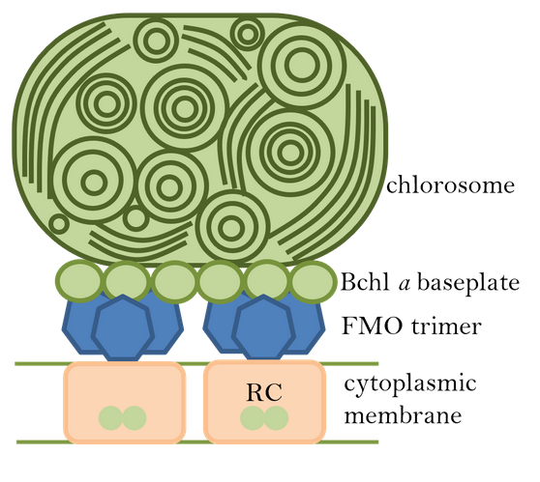
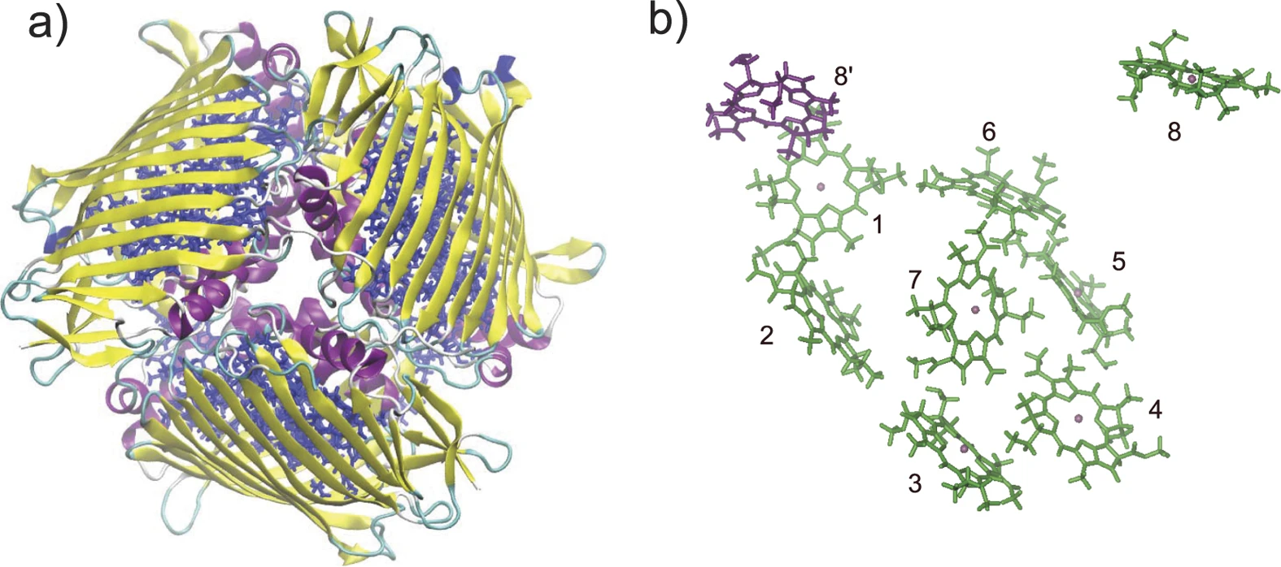
Fenna-Matthews-Olson (FMO) complex
Figure credit: Jia, X., Mei, Y., Zhang, J. et al. Sci Rep 5, 17096 (2015). CC BY 4.0
Notes:
Notice that the Fluorescence spectrum plotted here is not shifted at all

Slide 12
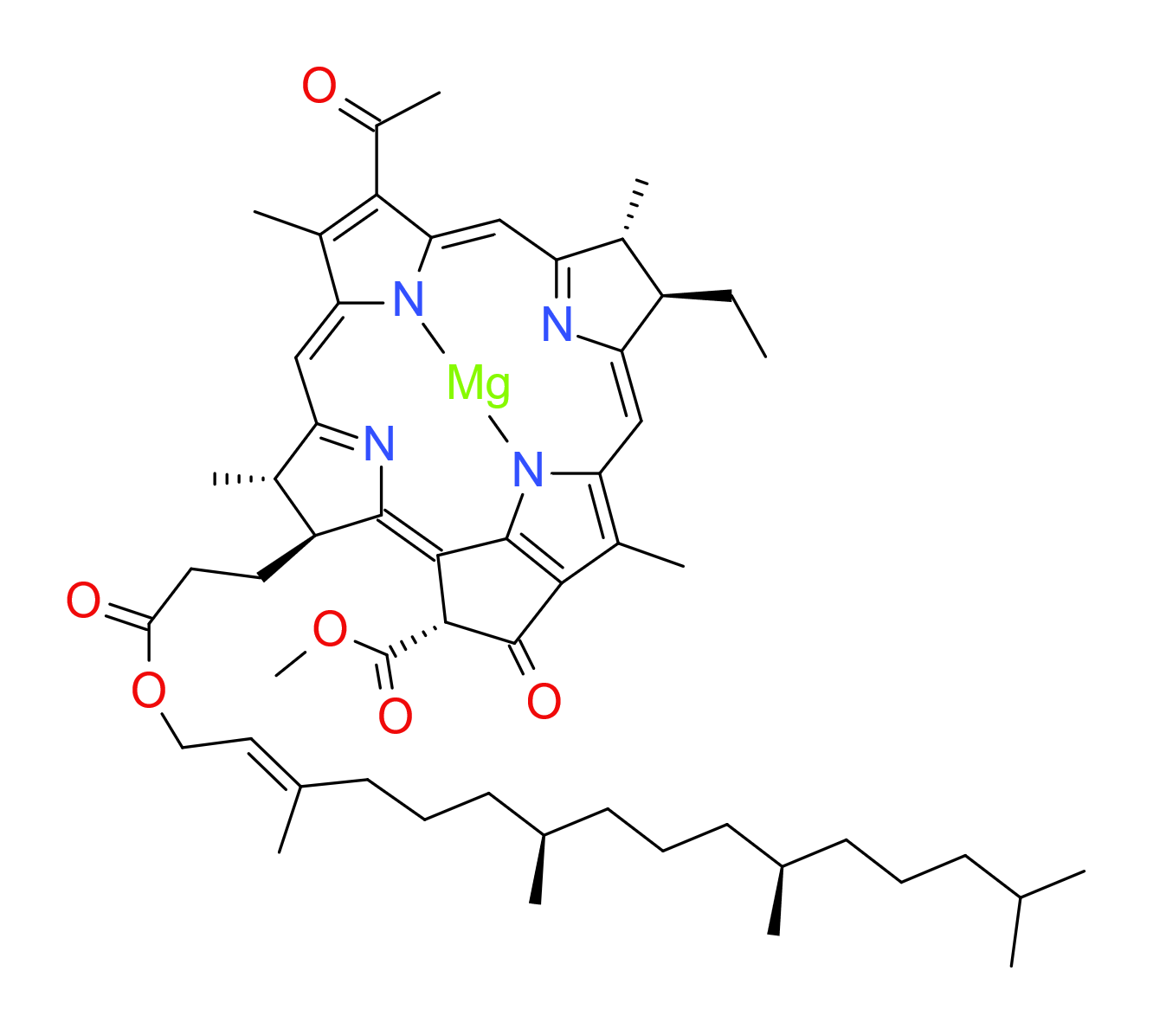
Bacteriochlorophyll a
Notes:
Notice that the Fluorescence spectrum plotted here is not shifted at all

Slide 13
+
+
+
+
-
-
-
-
Bacteriochlorophyll a
Notes:
Notice that the Fluorescence spectrum plotted here is not shifted at all

Slide 14
-
-
-
+
-
-
-
-
Notes:
Notice that the Fluorescence spectrum plotted here is not shifted at all

Slide 15
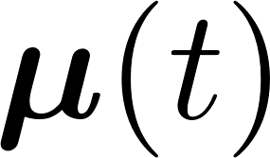
-
-
-
-
-
-
E
-
-
+
-
-
+
-
-
-
-
Notes:
Notice that the Fluorescence spectrum plotted here is not shifted at all

Slide 16
-
-
-
E
-
+
-
+
-
-
-
Notes:
Notice that the Fluorescence spectrum plotted here is not shifted at all

Slide 17
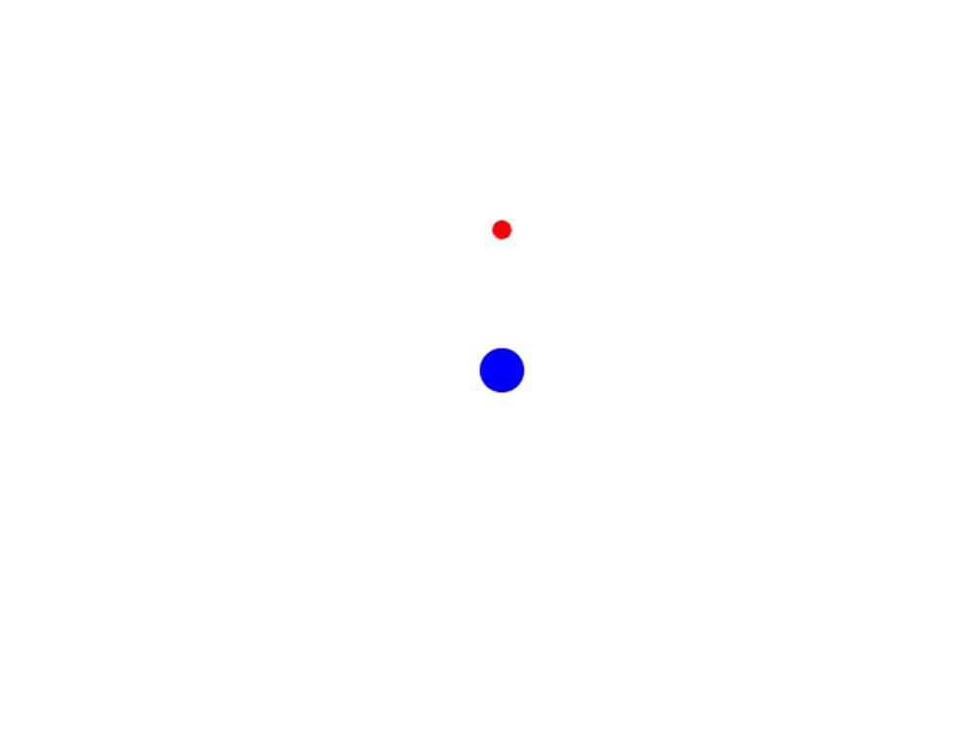
electron
nucleus
“pigment molecule”
Notes:
Notice that the Fluorescence spectrum plotted here is not shifted at all

Slide 18
FMO complex
Notes:
Notice that the Fluorescence spectrum plotted here is not shifted at all

Slide 19
Notes:
restonring force

Slide 20
Based on our conceptual model:
light causes oscillations in the charges of the pigment molecules
Notes:
restonring force

Slide 21
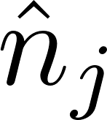
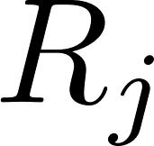
Notes:
Notice that the Fluorescence spectrum plotted here is not shifted at all

Slide 22
Notes:
Notice that the Fluorescence spectrum plotted here is not shifted at all

Slide 23
Notes:
Notice that the Fluorescence spectrum plotted here is not shifted at all

Slide 24
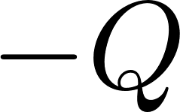
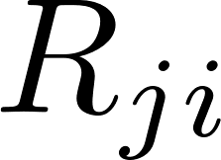
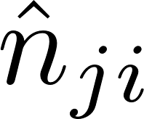
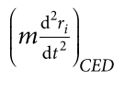
i
j
centre of mass of i
Notes:
centre of mass

Slide 25
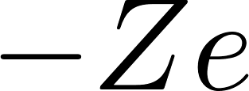
i
j
Notes:
check Ham

Slide 26
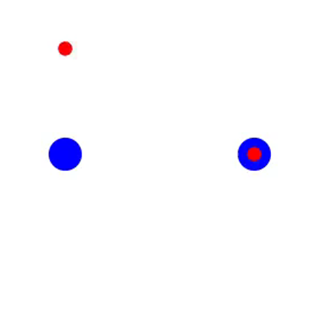
starting position
pigments are coupled (they interact)
Notes:
initial state

Slide 27
starting position
Notes:
initial state

Slide 28
=
+
eigenstate 1
eigenstate 2
en = 4
en = 2
Notes:
Notice that the Fluorescence spectrum plotted here is not shifted at all

Slide 29
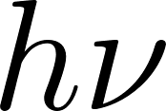
=
+
exciton 1
exciton 2
eigenstate 1
eigenstate 2
en = 4
en = 2
Notes:
Notice that the Fluorescence spectrum plotted here is not shifted at all

Slide 30
Based on our conceptual model:
light causes oscillations in the charges of the pigment molecules
pigment molecules interact such that excitation (by light) of one causes excitation in some others (delocalization)
Notes:
restonring force

Slide 31
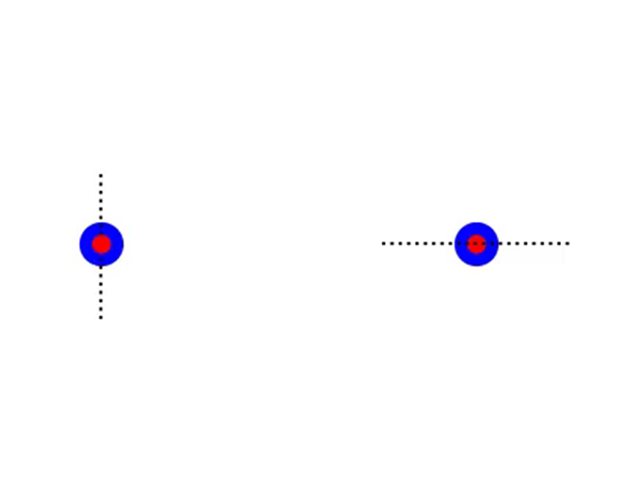
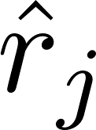
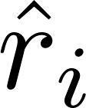
j
i
Bacteriochlorophyll a
transition dipole moments
Notes:
Notice that the Fluorescence spectrum plotted here is not shifted at all

Slide 32
Notes:
Notice that the Fluorescence spectrum plotted here is not shifted at all

Slide 33
Notes:
Notice that the Fluorescence spectrum plotted here is not shifted at all

Slide 34
eigenstate 1
eigenstate 2
eigenstate 3
en = ε₁
en = ε₂
en = ε₃
Notes:
Notice that the Fluorescence spectrum plotted here is not shifted at all

Slide 35
Based on our conceptual model:
light causes oscillations in the charges of the pigment molecules
pigment molecules interact such that excitation (by light) of one causes excitation in some others (delocalization)
the orientation of pigment molecules determine the extent of delocalization
Notes:
restonring force

Slide 36
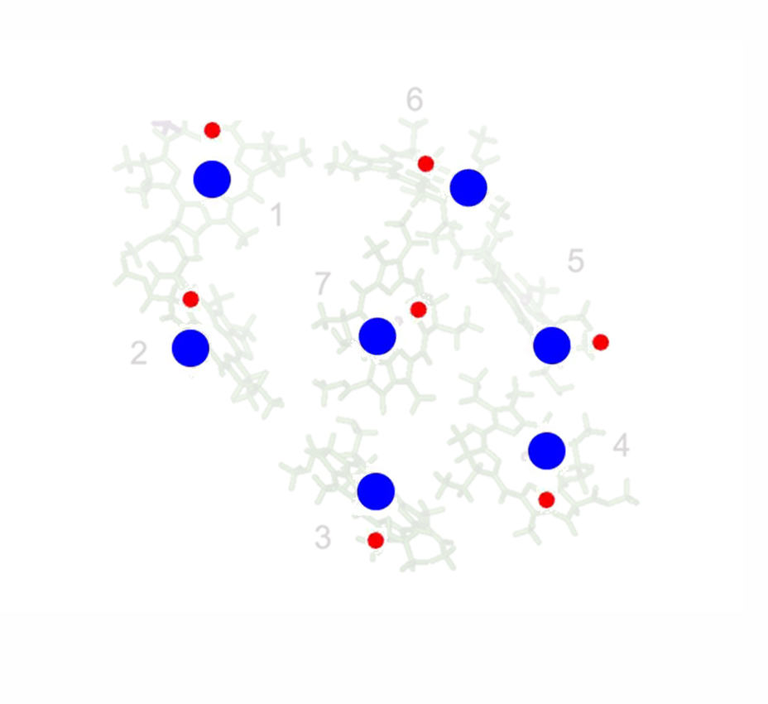
good
Notes:
Notice that the Fluorescence spectrum plotted here is not shifted at all

Slide 37
good
not good
Notes:
fmo is used for transfer

Slide 38
Notes:
Notice that the Fluorescence spectrum plotted here is not shifted at all

Slide 39
energy transfer
energy transfer
eigenstate 1
eigenstate 1
eigenstate 2
eigenstate 2
eigenstate 3
eigenstate 3
en = ε₁
en = ε₁
en = ε₂
en = ε₂
en = ε₃
en = ε₃
Notes:
Notice that the Fluorescence spectrum plotted here is not shifted at all

Slide 40
energy transfer
energy transfer
eigenstate 1
eigenstate 1
eigenstate 2
eigenstate 2
eigenstate 3
eigenstate 3
en = ε₁
en = ε₁
en = ε₂
en = ε₂
en = ε₃
en = ε₃
Notes:
Notice that the Fluorescence spectrum plotted here is not shifted at all

Slide 41
Based on our conceptual model:
light causes oscillations in the charges of the pigment molecules
pigment molecules interact such that excitation (by light) of one causes excitation in some others (delocalization)
the orientation of pigment molecules determine the extent of delocalization
nuclear motion can cause energy transfer between eigenstates (the energy is transferred to nuclear vibrations)
Notes:
restonring force

Slide 42
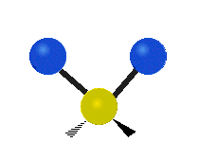
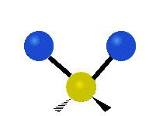
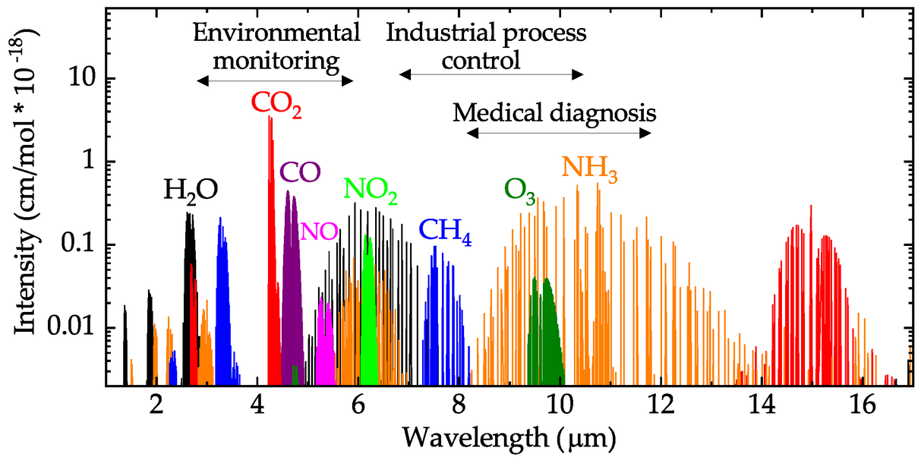
Asymmetrical Stretch | Symmetrical Stretch | Bending or Scissoring
Daniel Popa and Florin Udrea (CC BY SA 4.0 )
Rocking | Twisting | Wagging
LibreTexts CC BY 4.0
Notes:
imagine 1000 nuclei

Slide 43
Asymmetrical Stretch | Symmetrical Stretch | Bending or Scissoring
Daniel Popa and Florin Udrea (CC BY SA 4.0 )
Rocking | Twisting | Wagging
LibreTexts CC BY 4.0
FMO
Notes:
imagine 1000 nuclei

Slide 44
^{e-}
Notes:
Notice that the Fluorescence spectrum plotted here is not shifted at all

Slide 45
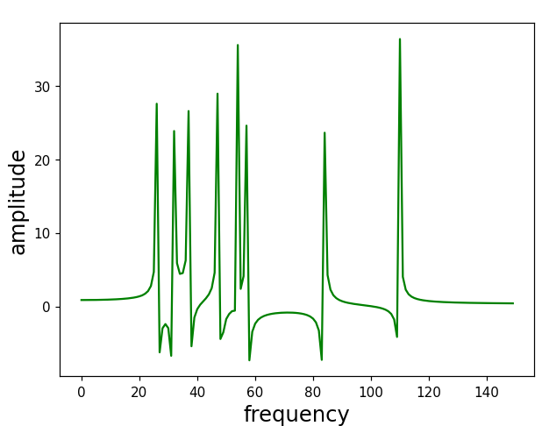
^{e-}
Fourier transform
Notes:
Notice that the Fluorescence spectrum plotted here is not shifted at all

Slide 46
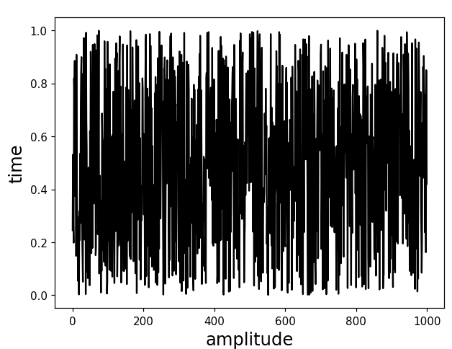
Langevin equation:
e⁻
restoring
force
drag
random force
Notes:
Notice that the Fluorescence spectrum plotted here is not shifted at all

Slide 47
e⁻
restoring
force
drag
random force
second lecture…
Notes:
Notice that the Fluorescence spectrum plotted here is not shifted at all

Slide 48
Notes:
Notice that the Fluorescence spectrum plotted here is not shifted at all

Slide 49
Notes:
whats x

Slide 50
t
1
Notes:
Notice that the Fluorescence spectrum plotted here is not shifted at all

Slide 51
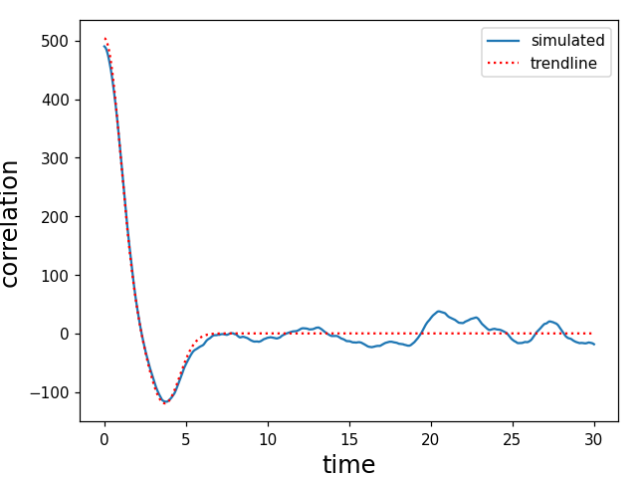
t
contains information about
dipole oscillation (frequency)
nuclear oscillations
Notes:
revision

Slide 52
Based on our conceptual model:
light causes oscillations in the charges of the pigment molecules
pigment molecules interact such that excitation (by light) of one causes excitation in some others (delocalization)
the orientation of pigment molecules determine the extent of delocalization
nuclear motion can cause energy transfer between eigenstates (the energy is transferred to nuclear vibrations)
nuclear motions has the form of correlated random noise; the correlation function of the charge fluctuation gives information about the frequency of the charge fluctuation as well as the nuclear vibrations.
Notes:
restonring force

Slide 53
and that’s how far classical physics takes us…
Notes:
restonring force

Slide 54
Classical
Notes:
Notice that the Fluorescence spectrum plotted here is not shifted at all

Slide 55
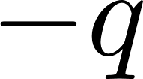
Classical
Notes:
Notice that the Fluorescence spectrum plotted here is not shifted at all

Slide 56
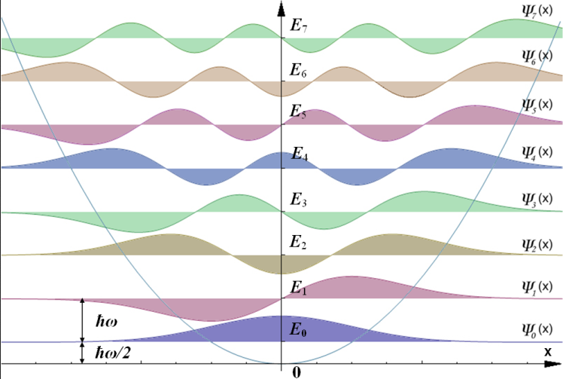
Classical
Quantum
Notes:
Notice that the Fluorescence spectrum plotted here is not shifted at all

Slide 57
Classical
Quantum
Notes:
Notice that the Fluorescence spectrum plotted here is not shifted at all

Slide 58
Classical
Quantum
Notes:
Notice that the Fluorescence spectrum plotted here is not shifted at all

Slide 59
Quantum
Our classical model did not have states
Notes:
Notice that the Fluorescence spectrum plotted here is not shifted at all

Slide 60
Quantum
Notes:
Notice that the Fluorescence spectrum plotted here is not shifted at all

Slide 61
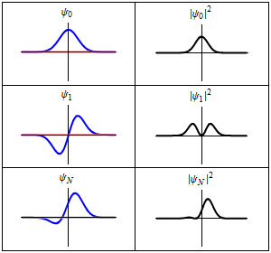
Quantum
Notes:
Notice that the Fluorescence spectrum plotted here is not shifted at all

Slide 62
Quantum
Notes:
Notice that the Fluorescence spectrum plotted here is not shifted at all

Slide 63
Quantum
Notes:
Notice that the Fluorescence spectrum plotted here is not shifted at all

Slide 64
Quantum
Notes:
Notice that the Fluorescence spectrum plotted here is not shifted at all

Slide 65
Quantum
oh ya, sometimes
Notes:
Notice that the Fluorescence spectrum plotted here is not shifted at all

Slide 66
Quantum
Notes:
=C=0

Slide 67
Quantum
Notes:
=C=0

Slide 68
Quantum
Notes:
=C=0

Slide 69
Quantum
Transition dipole moment
Notes:
=C=0

Slide 70
Classical
Quantum
But atoms don’t look like harmonic oscillators!
Notes:
Notice that the Fluorescence spectrum plotted here is not shifted at all

Slide 71
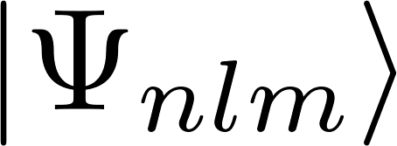
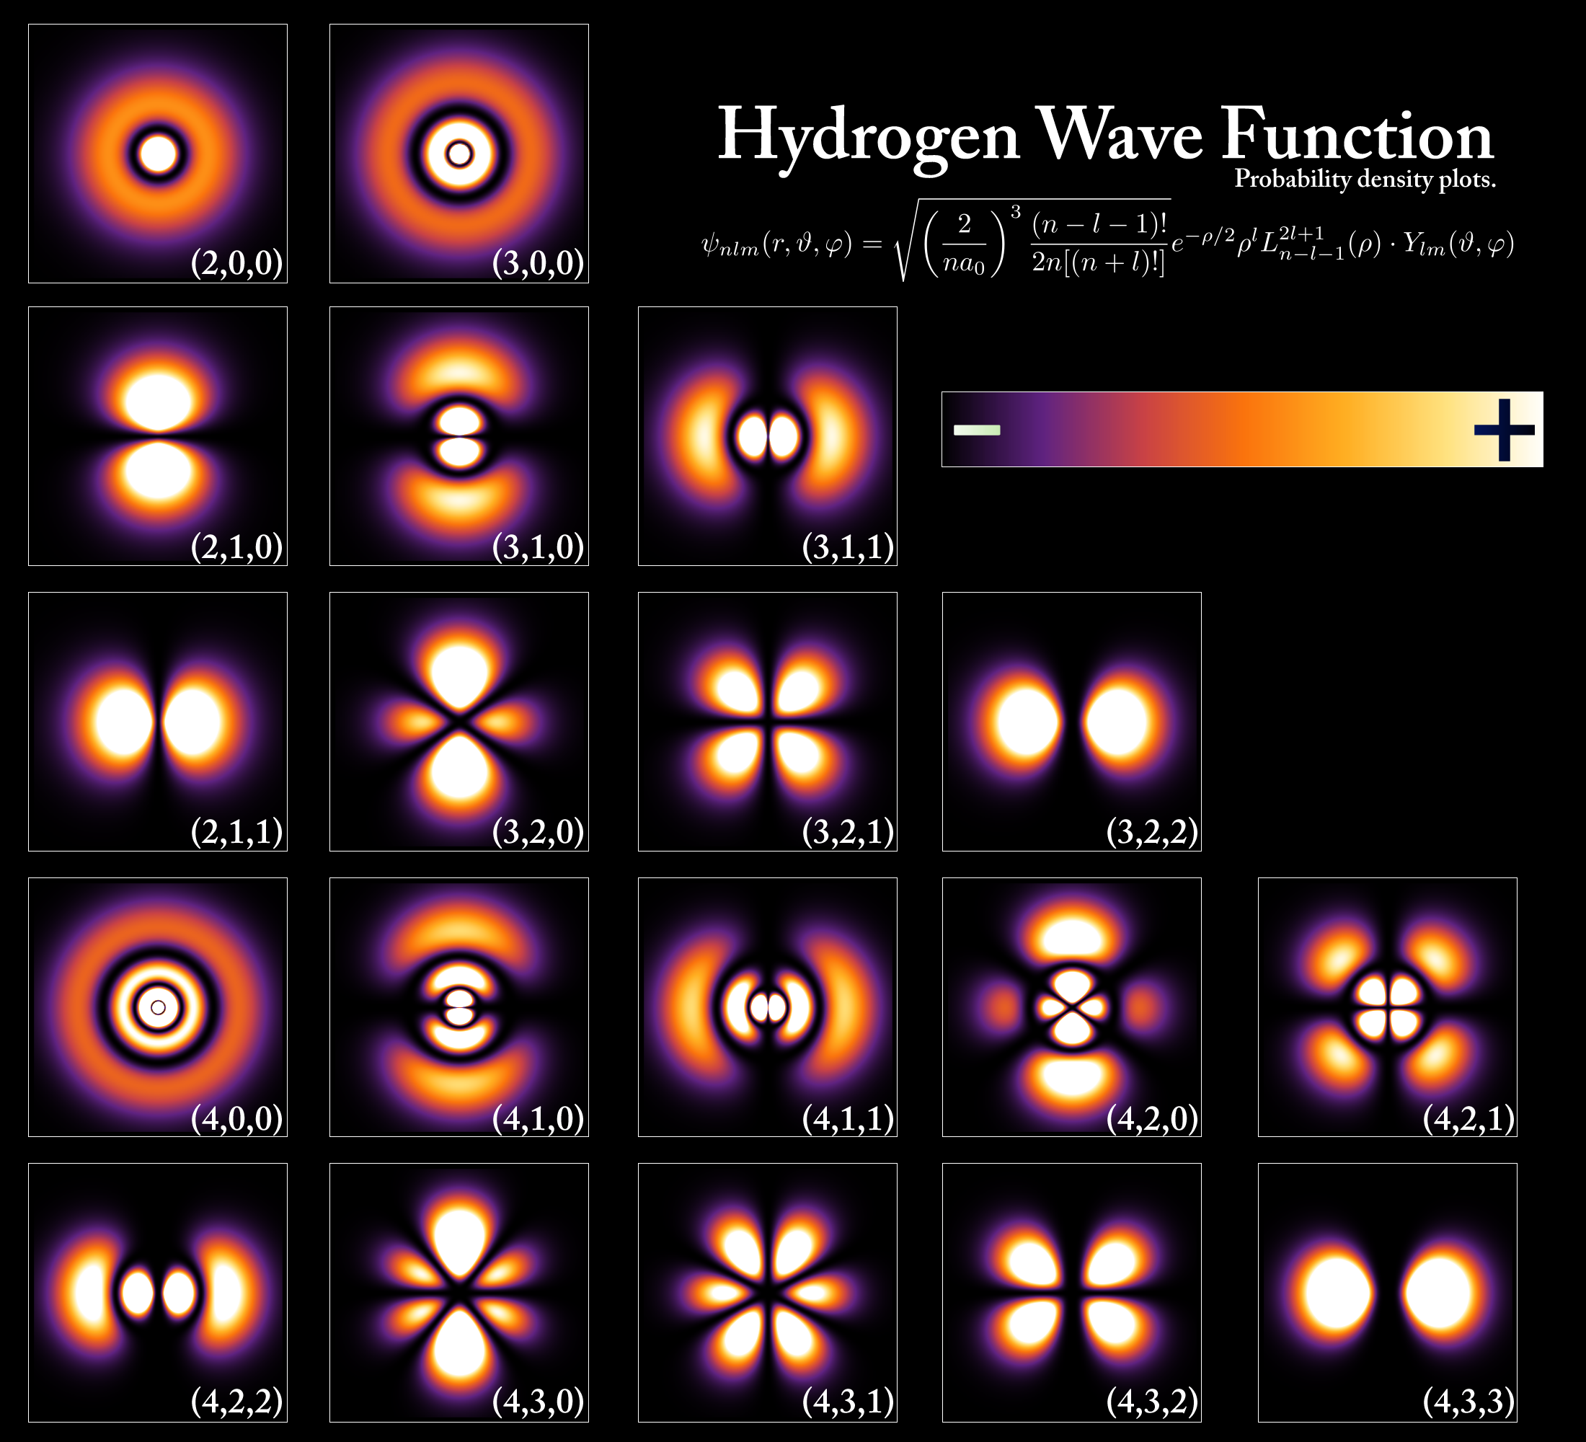
PoorLeno via Wikimedia Commons. Public Domain
Notes:
Notice that the Fluorescence spectrum plotted here is not shifted at all

Slide 72
Notes:
Notice that the Fluorescence spectrum plotted here is not shifted at all

Slide 73
But pigment molecules are not hydrogen atoms!
Notes:
Notice that the Fluorescence spectrum plotted here is not shifted at all

Slide 74
Notes:
Notice that the Fluorescence spectrum plotted here is not shifted at all

Slide 75
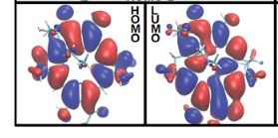
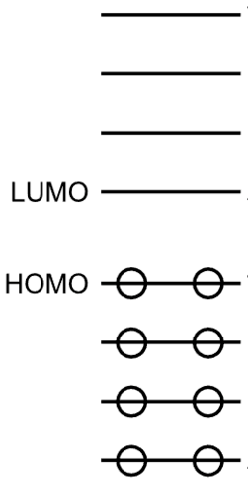
Song et al. Chem. Sci., 2019, 10, 8143–8153
For dipole moment:
Notes:
Notice that the Fluorescence spectrum plotted here is not shifted at all

Slide 76
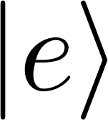
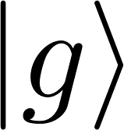
Song et al. Chem. Sci., 2019, 10, 8143–8153
excited
ground
Notes:
Notice that the Fluorescence spectrum plotted here is not shifted at all

Slide 77
Song et al. Chem. Sci., 2019, 10, 8143–8153
excited
electron
nucleus
ground
not bad ;-)
Notes:
Notice that the Fluorescence spectrum plotted here is not shifted at all

Slide 78
Based on our conceptual model:
✔
light causes oscillations in the charges of the pigment molecules
pigment molecules interact such that excitation (by light) of one causes excitation in some others (delocalization)
the orientation of pigment molecules determine the extent of delocalization
nuclear motion can cause energy transfer between eigenstates (the energy is transferred to nuclear vibrations)
nuclear motions has the form of correlated random noise; the correlation function of the charge fluctuation gives information about the frequency of the charge fluctuation as well as the nuclear vibrations.
Notes:
restonring force

Slide 79
1 2 3 4 5 6 7
Notes:
Notice that the Fluorescence spectrum plotted here is not shifted at all

Slide 80
1 2 3 4 5 6 7
Notes:
Notice that the Fluorescence spectrum plotted here is not shifted at all

Slide 81
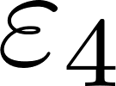
1 2 3 4 5 6 7
Notes:
Notice that the Fluorescence spectrum plotted here is not shifted at all

Slide 82
J=$\frac{1}{4πε}\frac{{\vec{μ}}_{4}^{ge}⋅{\vec{μ}}_{5}^{ge}−3\left({\vec{μ}}_{1}^{ge}⋅\hat{r}\right)\left({\vec{μ}}_{2}^{ge}⋅\hat{r}\right)}{r^{3}}$
1 2 3 4 5 6 7
Notes:
Notice that the Fluorescence spectrum plotted here is not shifted at all

Slide 83
change of basis
J=$\frac{1}{4πε}\frac{{\vec{μ}}_{4}^{ge}⋅{\vec{μ}}_{5}^{ge}−3\left({\vec{μ}}_{1}^{ge}⋅\hat{r}\right)\left({\vec{μ}}_{2}^{ge}⋅\hat{r}\right)}{r^{3}}$
1 2 3 4 5 6 7
Notes:
Notice that the Fluorescence spectrum plotted here is not shifted at all

Slide 84
change of basis
J=$\frac{1}{4πε}\frac{{\vec{μ}}_{4}^{ge}⋅{\vec{μ}}_{5}^{ge}−3\left({\vec{μ}}_{1}^{ge}⋅\hat{r}\right)\left({\vec{μ}}_{2}^{ge}⋅\hat{r}\right)}{r^{3}}$
eigenenergies
exciton energies
1 2 3 4 5 6 7
Hamiltonian eigenstates
(excitons)
Notes:
Notice that the Fluorescence spectrum plotted here is not shifted at all

Slide 85
Based on our conceptual model:
light causes oscillations in the charges of the pigment molecules
pigment molecules interact such that excitation (by light) of one causes excitation in some others (delocalization)
the orientation of pigment molecules determine the extent of delocalization
nuclear motion can cause energy transfer between eigenstates (the energy is transferred to nuclear vibrations)
nuclear motions has the form of correlated random noise; the correlation function of the charge fluctuation gives information about the frequency of the charge fluctuation as well as the nuclear vibrations.
✔
Notes:
restonring force

Slide 86
change of basis
J=$\frac{1}{4πε}\frac{{\vec{μ}}_{4}^{ge}⋅{\vec{μ}}_{5}^{ge}−3\left({\vec{μ}}_{1}^{ge}⋅\hat{r}\right)\left({\vec{μ}}_{2}^{ge}⋅\hat{r}\right)}{r^{3}}$
1 2 3 4 5 6 7
Notes:
Notice that the Fluorescence spectrum plotted here is not shifted at all

Slide 87
Based on our conceptual model:
light causes oscillations in the charges of the pigment molecules
pigment molecules interact such that excitation (by light) of one causes excitation in some others (delocalization)
the orientation of pigment molecules determine the extent of delocalization
nuclear motion can cause energy transfer between eigenstates (the energy is transferred to nuclear vibrations)
nuclear motions has the form of correlated random noise; the correlation function of the charge fluctuation gives information about the frequency of the charge fluctuation as well as the nuclear vibrations.
✔
Notes:
restonring force

Slide 88
Based on our conceptual model:
light causes oscillations in the charges of the pigment molecules
pigment molecules interact such that excitation (by light) of one causes excitation in some others (delocalization)
the orientation of pigment molecules determine the extent of delocalization
nuclear motion can cause energy transfer between eigenstates (the energy is transferred to nuclear vibrations)
nuclear motions has the form of correlated random noise; the correlation function of the charge fluctuation gives information about the frequency of the charge fluctuation as well as the nuclear vibrations.
✔
next lecture
Notes:
restonring force

Slide 89
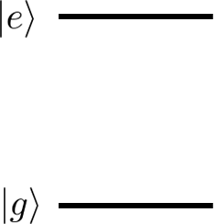
superposition (exciton) state
Only pigment 1 excited
Only pigment 2 excited
1
S
2
Notes:
Doel van L1 & 2 is om onderbou te gee vir L3 & 4.

Slide 90
coherences
1
S
2
populations
Notes:
HOW IN BASIS?

Slide 91
coherences
1
S
2
populations
Notes:
Doel van L1 & 2 is om onderbou te gee vir L3 & 4.

Slide 92
coherences
1
S
2
populations
Notes:
Doel van L1 & 2 is om onderbou te gee vir L3 & 4.

Slide 93
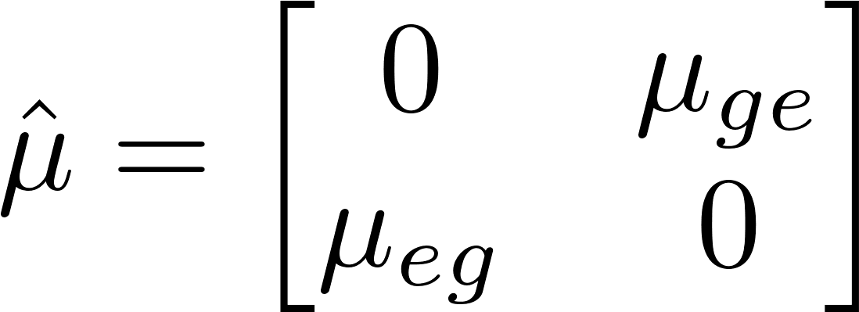
We looked at
x-dimension
In the basis of and :
Notes:
OFF DIAGONAL RHO ILLUSTRATE

Slide 94
In the basis of and :
Notes:
OFF DIAGONAL RHO ILLUSTRATE

Slide 95
In the basis of and :
Expectation value of the dipole moment can be calculated from the ground-excited state coherence of the density matrix
Notes:
OFF DIAGONAL RHO ILLUSTRATE

Slide 96
In the basis of and :
Notes:
OFF DIAGONAL RHO ILLUSTRATE

Slide 97
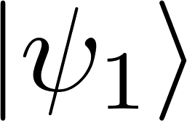
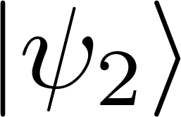
state preparation
50%
50%
Total state
Notes:
Doel van L1 & 2 is om onderbou te gee vir L3 & 4.

Slide 98
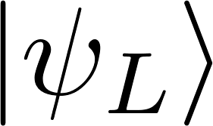
1. 50% and 50%
2. 100% in
Notes:
SKETS

Slide 99
1. 50% and 50%
2. 100% in
Notes:
Doel van L1 & 2 is om onderbou te gee vir L3 & 4.

Slide 100
1. 50% and 50%
2. 100% in
P(R) = 50%, P(L) = 50%
But…
Notes:
Doel van L1 & 2 is om onderbou te gee vir L3 & 4.

Slide 101
1. 50% and 50%
2. 100% in
P(R) = 50%, P(L) = 50%
But…
interference
Notes:
VERKEERD

Slide 102
1. 50% and 50%
2. 100% in
interference
Notes:
Doel van L1 & 2 is om onderbou te gee vir L3 & 4.

Slide 103
We defined
Let’s extend the definition:
probability to be in
Notes:
Notice that the Fluorescence spectrum plotted here is not shifted at all

Slide 104
We defined
Let’s extend the definition:
probability to be in
1. 50% and 50%
Notes:
Notice that the Fluorescence spectrum plotted here is not shifted at all

Slide 105
How does it evolve in time
Schrödinger equation
Liouville-von Neumann equation
Notes:
Notice that the Fluorescence spectrum plotted here is not shifted at all

Slide 106
Works for pure quantum states, as well as classical mixtures of quantum states!
Liouville-von Neumann equation
and
50%
50%
Notes:
Notice that the Fluorescence spectrum plotted here is not shifted at all

Slide 107
Consider the pure states
sum
difference
Notes:
Notice that the Fluorescence spectrum plotted here is not shifted at all

Slide 108
Consider the pure states
sum
difference
Notes:
Notice that the Fluorescence spectrum plotted here is not shifted at all

Slide 109
Consider the pure states
sum
difference
Density operator can be represented in different bases
Notes:
Notice that the Fluorescence spectrum plotted here is not shifted at all

Slide 110
coherence
Well-defined phase relationship between different states in the system
Notes:
Notice that the Fluorescence spectrum plotted here is not shifted at all

Slide 111
In any system, a pure state can be written as eigenfunctions of the Hamiltonian
Use definition
Well-defined phase relationship
Notes:
Notice that the Fluorescence spectrum plotted here is not shifted at all

Slide 112
In any system, a pure state can be written as eigenfunctions of the Hamiltonian
Use definition
Pure state is always coherent (in any basis)
Well-defined phase relationship
Notes:
Notice that the Fluorescence spectrum plotted here is not shifted at all

Slide 113
E₁
E₂
E
1
S
2
Notes:
Doel van L1 & 2 is om onderbou te gee vir L3 & 4.

Slide 114
E₁
E₂
E
1
S
2
Notes:
Doel van L1 & 2 is om onderbou te gee vir L3 & 4.

Slide 115
At equilibrium:
E
1
S
2
Notes:
Doel van L1 & 2 is om onderbou te gee vir L3 & 4.

Slide 116
t
this was for a classical system,
but quantum systems also lose their phase coherence
Notes:
Notice that the Fluorescence spectrum plotted here is not shifted at all

Slide 117
Decoherence
initial state
interaction
system-bath entanglement (inevitable)
Thanks for writing this out, ChatGPT
effectively
Notes:
Notice that the Fluorescence spectrum plotted here is not shifted at all

Slide 118
Decoherence due to fluctuations in the energy gap
The following approach is from this book
Notes:
Doel van L1 & 2 is om onderbou te gee vir L3 & 4.

Slide 119
rewrite
redefine
would imply no interaction, i.e.,
Notes:
Doel van L1 & 2 is om onderbou te gee vir L3 & 4.

Slide 120
from previous slide:
dropped for convenience
0
formal solution
Notes:
Doel van L1 & 2 is om onderbou te gee vir L3 & 4.

